Slide 1

Lecture 10.3
Mixed-effects models
Nicola Romanò nicola.romano@ed.ac.uk
13-11-2019

Slide 2
Learning objectives
At the end of this lecture you should be able to:
Identify fixed and random effects in an experimental scenario
Describe the problem associated with ignoring random effects or considering them as fixed
Give a basic explanation of what a mixed effect model is and code it in R*
Interpret the output of a mixed effect model*
* These last two points will be complemented by what you will learn in the next R workshop.
Notes:
Pancreas, genotype
<number>

Slide 3
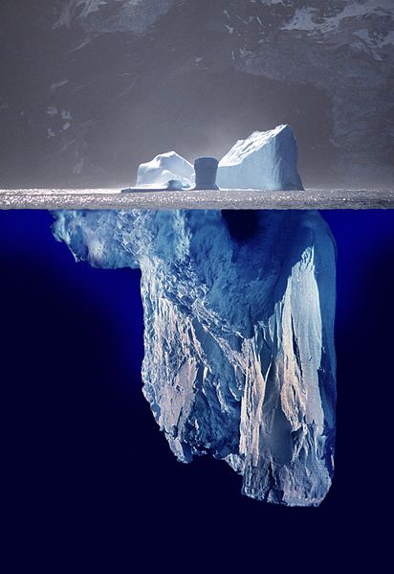
WARNING!
Mixed-effects models are a complex topic
We could offer a whole course or two on this topic alone, so we’re just scratching the surface today…
If anyone is really interested in this... two good reference books are:
“Mixed Effects Models in S and S-PLUS” by Douglas Bates and José Pinheiro
“Extending the Linear Model with R” by Julian Faraway
Notes:
Pancreas, genotype
<number>

Slide 4
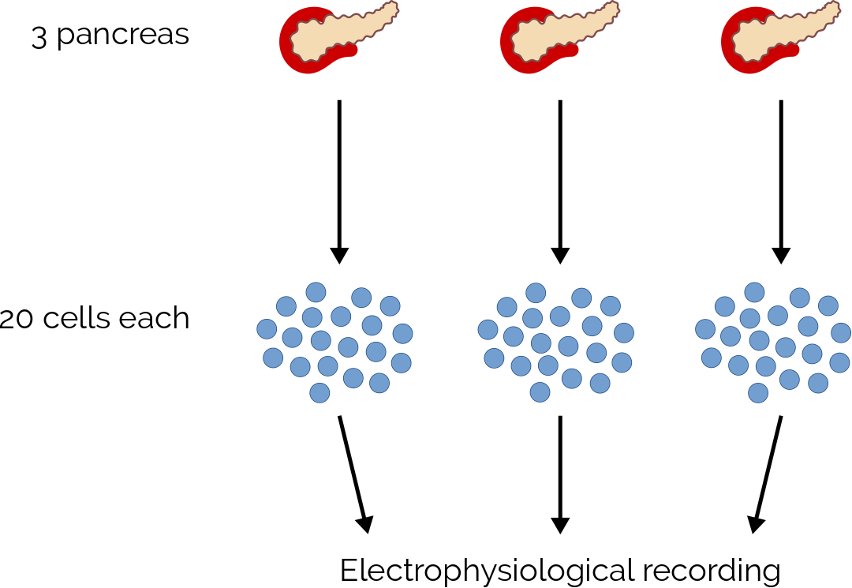
Nested design
wt
KO
n = 60 cells from 3 pancreas. Record membrane potential.
What factors are influencing the response?
Notes:
Pancreas, genotype
<number>

Slide 5
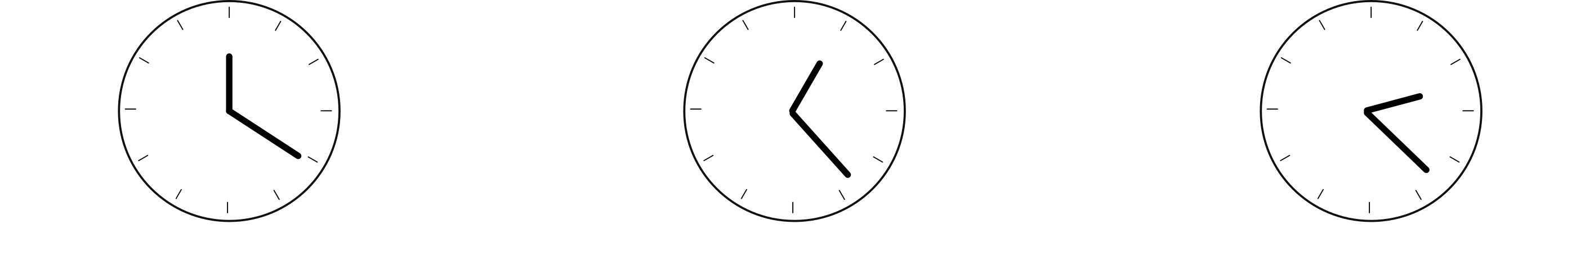

Repeated measures design
Males
(n = 10)
Females
(n = 10)
n = 20 mice (10 M, 10 F). Record glucose level over time.
What factors are influencing the response?
Notes:
Time, Sex, Mouse
<number>

Slide 6
Fixed and random effects
Two types of factors influence our outcome:
- Factors that we want to study ← Fixed effects
- “Nuisance” factor ← Random effect
The linear models we have seen so far only contain fixed effects.
Random effects are also contributing to data variance, but depend on the specific sample, so estimating coefficients for them is not useful.
A model containing only fixed effects is called a fixed effect model
A model containing only random effects is called a random effect model
A mixed effect model contains both fixed and random effects.
Notes:
<number>

Slide 7
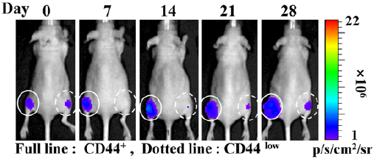
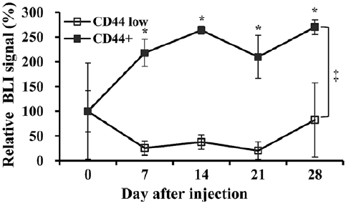
Fixed and random effects
Kim and colleagues implanted two different types of cancer cell (genetically modified so that they emit luminescence) in the left and right mammary gland of mice.
They then imaged the mice over four weeks to determine the growth of the tumoral mass.
What are the fixed and the random effects?
Notes:
Fixed: time, cell type
Random: rat
<number>

Slide 8
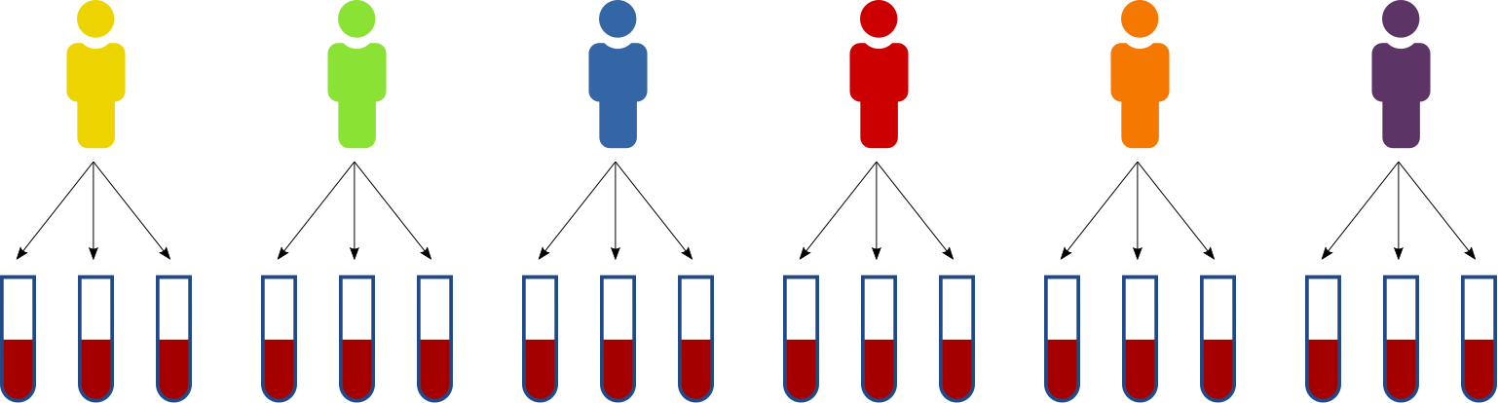
A simple example
I measure the level of thyroxine in six individuals, in three different occasions.
Let’s ignore the nested structure of the samples and treat them as independent
Important: we are only doing this to explain why mixed effects models are useful, you should NOT ignore nesting!
Notes:
<number>

Slide 9
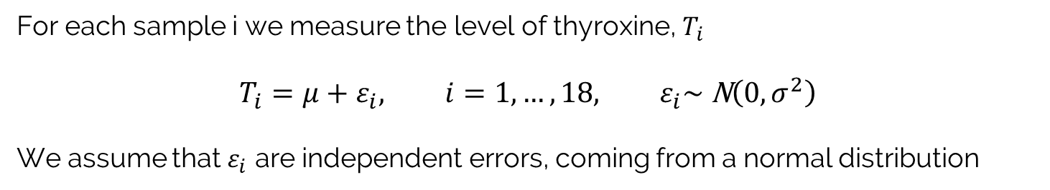
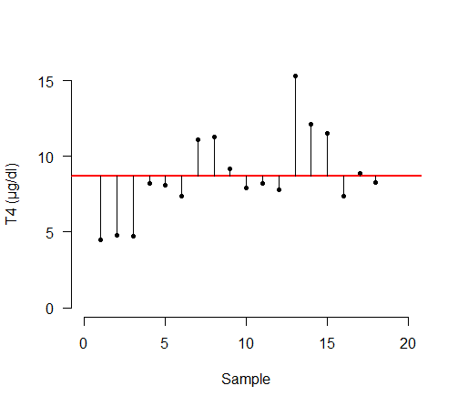
A simple example
> head(T4)
Level Patient
1 4.5 1
2 4.8 1
3 4.7 1
4 8.2 2
5 8.1 2
6 7.4 2
µ
Notes:
<number>

Slide 10
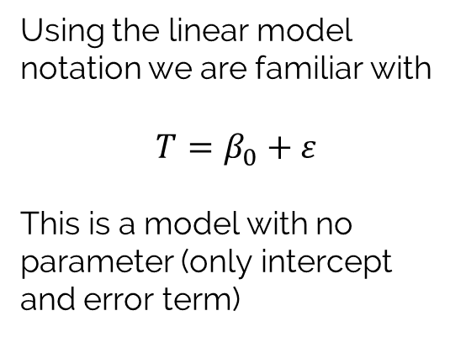
A simple example
# ~ 1 means we only model the intercept
model <- lm(Level ~ 1, data = T4)
summary(model)
Call:
lm(formula = Level ~ 1, data = T3)
Residuals:
Min 1Q Median 3Q Max
-4.2056 -1.2056 -0.5056 1.9194 6.5944
Coefficients:
Estimate Std. Error t value Pr(>|t|)
(Intercept) 8.706 0.653 13.33 1.98e-10 ***
---
Signif. codes: 0 ‘***’ 0.001 ‘**’ 0.01 ‘*’ 0.05 ‘.’ 0.1 ‘ ’ 1
Residual standard error: 2.77 on 17 degrees of freedom
8.706
Notes:
<number>

Slide 11
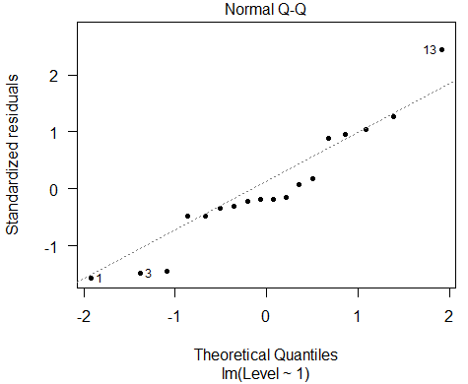
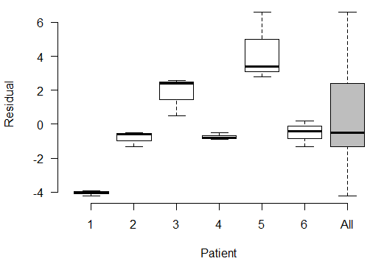
The problem is…
The “patient effect” has been incorporated in the residuals
We have artificially increased the within-patient variability
Notes:
<number>

Slide 12
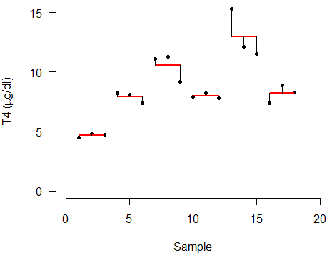
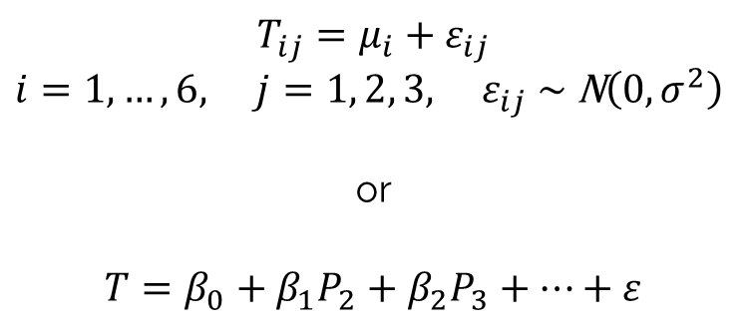
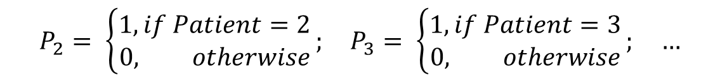
Improving the model
We could incorporate the patient in our model as a fixed effect. This will be represented as a factor with 6 levels, 1 to 6.
Where P2 to P6 are dummy variables to represent the 6-level factor “patient”
Notes:
<number>

Slide 13
Fixed-effects model
model.fix <- lm(Level ~ Patient, data = T4)
summary(model.fix)
Call:
lm(formula = Level ~ Patient, data = T4)
Residuals:
Min 1Q Median 3Q Max
-1.46667 -0.41667 0.06667 0.28333 2.33333
Coefficients:
Estimate Std. Error t value Pr(>|t|)
(Intercept) 4.6667 0.5936 7.861 4.50e-06 ***
Patient2 3.2333 0.8395 3.851 0.00230 **
Patient3 5.8667 0.8395 6.988 1.46e-05 ***
Patient4 3.3000 0.8395 3.931 0.00200 **
Patient5 8.3000 0.8395 9.886 4.05e-07 ***
Patient6 3.5333 0.8395 4.209 0.00121 **
---
Signif. codes: 0 ‘***’ 0.001 ‘**’ 0.01 ‘*’ 0.05 ‘.’ 0.1 ‘ ’ 1
Residual standard error: 1.028 on 12 degrees of freedom
Multiple R-squared: 0.9028, Adjusted R-squared: 0.8622
F-statistic: 22.28 on 5 and 12 DF, p-value: 1.088e-05
Mean of pat. 1: 4.6667
Mean of pat. 2: 4.6667 + 3.2333
Mean of pat. 3: 4.6667 + 5.8667
…
~2.7 fold decrease!
Notes:
<number>

Slide 14
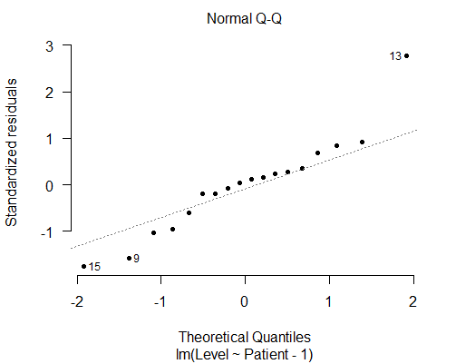
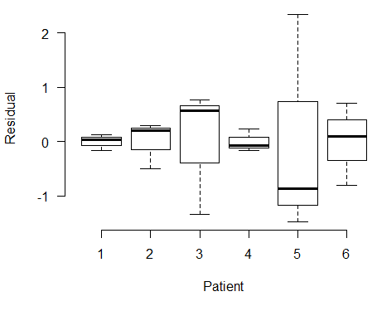
Fixed-effects model residuals
The mean of the residuals is now centred around 0 for each patient!
Notes:
<number>

Slide 15
Fixed-effects model
Is this model useful?
Not too much!
Only models those 6 specific patients.
Cannot extrapolate to a generic “patient 7”!
Does not provide a measure of between-patient variability
Needs 1 extra parameter for each new patient
Notes:
<number>

Slide 16

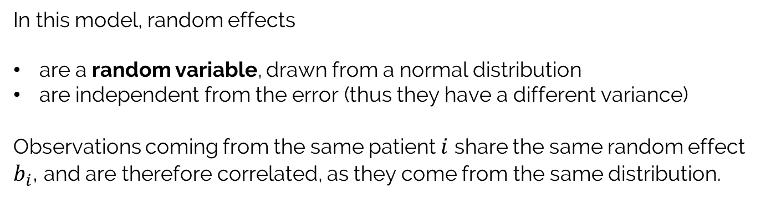
Random effects
We can reparametrize our model and treat patients as random effects
Notes:
<number>

Slide 17
Random effects model
library(nlme) # Needs to be installed first!
model.rnd <- lme(Level ~ 1, data = T4, random = ~ 1 | Patient)
summary(model.rnd)
Linear mixed-effects model fit by REML
Data: T4
AIC BIC logLik
73.59904 76.09868 -33.79952
Random effects:
Formula: ~1 | Patient
(Intercept) Residual
StdDev: 2.738572 1.028213
Fixed effects: Level ~ 1
Value Std.Error DF t-value p-value
(Intercept) 8.705556 1.143983 12 7.609863 0
Standardized Within-Group Residuals:
Min Q1 Med Q3 Max
-1.2404308 -0.4756779 -0.0718532 0.2411250 2.4553010
Number of Observations: 18
Number of Groups: 6
Goodness-of-fit measures
Notes:
<number>

Slide 18
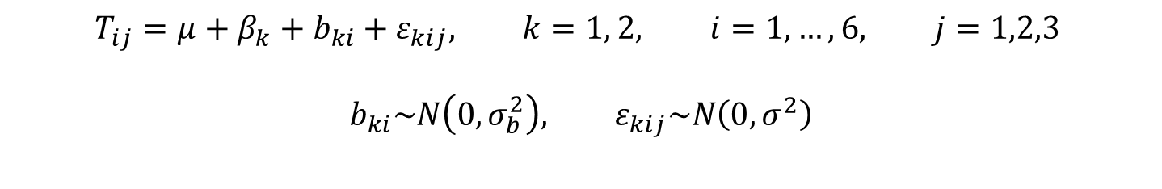
What about fixed effects?
Let’s imagine we have other 6 patients, with a different genotype.
Total 12 patients, 6 genotype A, 6 genotype B
A mixed effect model would be:
Notes:
<number>

Slide 19
Mixed effects model
model.mix <- lme(Level ~ Genotype, data = T4, random = ~ 1 | Patient)
summary(model.mix)
Linear mixed-effects model fit by REML
Data: T4
AIC BIC logLik
186.2225 192.3279 -89.11124
Random effects:
Formula: ~1 | Patient
(Intercept) Residual
StdDev: 5.37896 1.903953
Fixed effects: Level ~ Genotype
Value Std.Error DF t-value p-value
(Intercept) 8.705556 2.241337 24 3.884090 0.0007
GenotypeB 12.811719 3.169729 10 4.041897 0.0024
Correlation:
(Intr)
GenotypeB -0.707
Standardized Within-Group Residuals:
Min Q1 Med Q3 Max
-1.87642275 -0.43445309 -0.03279226 0.33914381 3.26399420
Number of Observations: 36
Number of Groups: 12
Notes:
<number>

Slide 20
Random intercepts…
We have coded the random effect as: ~ 1 | Patient
This means to assign a different intercept (indicated by the 1) to each patient, whilst keeping the same slope.
Indeed:
coef(model.mix)
(Intercept) GenotypeB
1 4.828582 12.81172
2 7.932294 12.81172
3 10.460059 12.81172
4 7.996288 12.81172
5 12.795843 12.81172
6 8.220267 12.81172
7 -1.021683 12.81172
8 7.202284 12.81172
9 11.553030 12.81172
10 7.138611 12.81172
11 20.184906 12.81172
12 7.176186 12.81172
Notes:
<number>

Slide 21
… and random slopes
We could have specified the random effect as: ~ Genotype | Patient
This would assign a different slope and intercept to each patient
(I could use ~ Genotype -1 | Patient to only assign a different slope)
Indeed:
coef(model.mix)
(Intercept) GenotypeB
1 5.288198 10.08194
2 8.023964 12.26726
3 10.252063 14.04707
4 8.080372 12.31232
5 12.310939 15.69169
6 8.277798 12.47003
7 6.395764 5.22157
8 8.348595 11.63872
9 9.381706 15.03360
10 8.333475 11.58903
11 11.431396 21.76904
12 8.342398 11.61835
Notes:
<number>

Slide 22
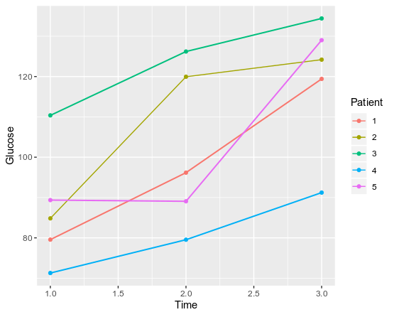
A final example
Increase in glucose levels after a meal.
15 observations from 5 subjects measured 3 times.
Notes:
<number>

Slide 23
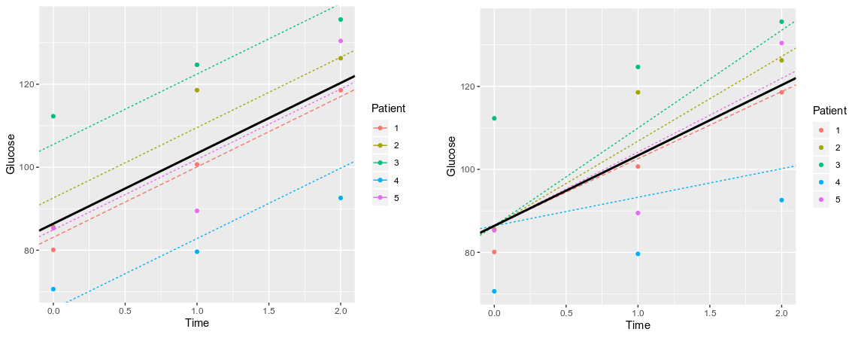
Random effects model
Random intercept (baseline glucose level) differs for each patient. Slope (rate of glucose change) is the same.
random = ~ 1 | Patient
Random intercept (baseline glucose level) is the same for each patient. Slope (rate of glucose change) changes
random = ~ Time - 1 | Patient
Notes:
<number>

Slide 24
What about nested designs?
Similar syntax, but nesting should be indicated in the random effect, using /
For example, analysing the grades of different classes in different schools we may use random = ~ 1 | School/Class
For a much more in depth explanation and examples
see R workshop #4, online on Friday!
Notes:
<number>

Slide 25

The experimental design
Tray 1
Gen A
Tray 2
Gen A
Tray 3
Gen B
Tray 4
Gen B
Tray 5
Gen A
Tray 6
Gen B
What are the fixed effects and the random effects?
Notes:
<number>

